Slide 1

Scrum – Agile Team
Laura McAroy

Slide 2
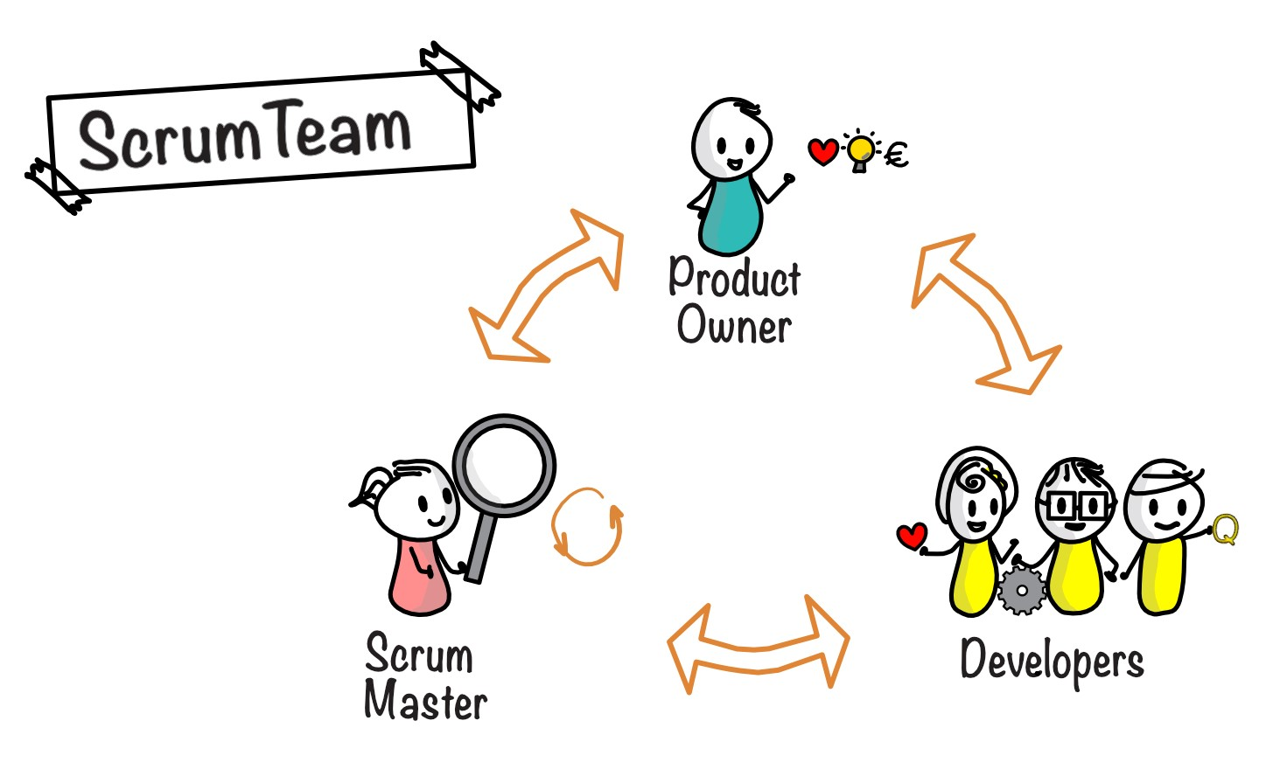
The Team
Product Owner – Meets with the clients and creates prioritized backlog. Focuses on making sure that the work done aligns with the work that needs to be done to meet the client’s expectations (2021)
Scrum Master – Biggest priority is to remove obstacles for the Scrum team (2021). Responsible for Sprint Planning, Daily Scrum, and Sprint Retrospective.
Development Team – Made up of architects, developers, testers, and designers (2021). Responsible for creating the project.

Slide 3
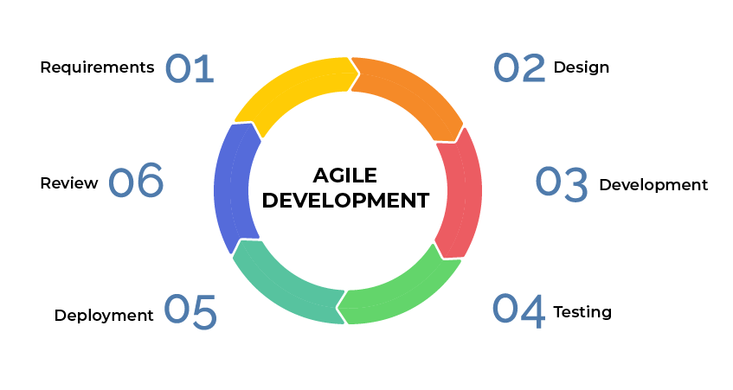
Concept
In the first stage of the development process, the Product Owner meets with the client to determine the requirements of the project and create initial backlog (2021).

Slide 4
Design
The Product Owner works with the Scrum Master to create teams to develop the project and gives them the tools they need to begin creating user stories and designing the project (2021).

Slide 5
Development
This is the longest stage, as it contains the sprints, where most of the development of the project is done. “This stage is a cornerstone of Agile software development, enabling developers to create working software quickly and make improvements to satisfy the client” (2021).

Slide 6
Testing
Once the project is developed, it enters a testing phase to make sure it is fully functional before it is released.

Slide 7
Deployment
Once the project has been tested and debugged, the team presents the completed work to the clients.

Slide 8
Review
The Scrum Master completes the Sprint Retrospective and Review, and the team remains available to provide ongoing support to the client and provide user training (2021).

Slide 9
Agile vs Waterfall
Changes are made continuously throughout the process
Can work on several project components at once
Because of this, agile projects are completed much quicker than traditional waterfall projects
All of the planning is done in the initial phases, no flexibility to return to previous steps to make changes
Components must be completed in order, one at a time
Because of this, waterfall projects take much to longer to produce functional software, let alone complete

Slide 10
Which one do you choose?
The biggest factor to consider when choosing a development method is PREDICTABILITY.
Waterfall method requires the exact requirements to be documented from the very beginning stages (George, 2021).
The agile method is most suitable for projects with high client involvement, like the SNHU Travel Project, as it leaves room for additional planning and changes to be made.

Slide 11
References
Alliance, S. (2021). Scrum Roles Demystified . Scrum Alliance. Retrieved December 12, 2021, from https://resources.scrumalliance.org/Article/scrum-roles-demystified.
George, T. (2021, November 2). Waterfall vs. Agile Project Management: Choosing the right approach . Focus. Retrieved December 12, 2021, from https://www.meistertask.com/blog/waterfall-vs-agile-project-management-choosing-the-right-approach/.
Wrike, Inc. (2021). The Agile Software Development Life cycle. Wrike Agile Guide. Retrieved December 12, 2021, from https://www.wrike.com/agile-guide/agile-development-life-cycle/.

